Slide 1
IEEE Python Workshop
4/23/2021

Slide 2
What is Python?
Python is an interpreted, high-level, dynamically typed programming language
Used for scripting and prototyping
Especially popular for data analysis and machine learning

Slide 3
Python Basics
The superfast Python Intro
https://colab.research.google.com/drive/1FZuA1N19z2-xT6wfhEzVRgXIwyFi-VJ_?usp=sharing

Slide 4
The Program
What are we coding?
https://colab.research.google.com/drive/1SW3-krotbXJKfcejoYD3OCpK_Mn2YIXJ?usp=sharing

Slide 5
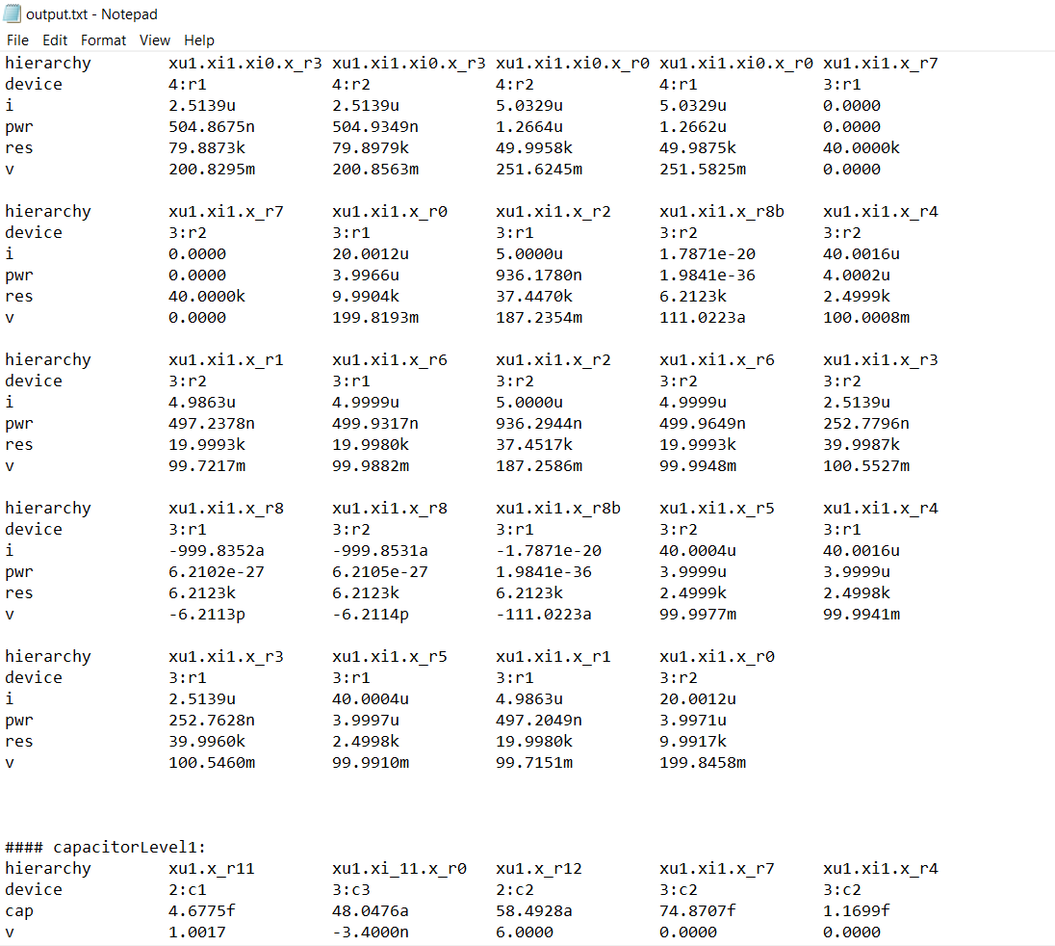
SPICE Output
On the left we have some SPICE simulation output
Over 2000 lines long
Somewhere in here are some components that are high when they shouldn’t be
How do we find offending components?

Slide 6
But like aren’t there tools that do that?
Yes, many more elaborate simulator can check for breakdown voltages and shorts and much more during the simulation
However, you are adding a check for every component in every simulation tick
This scales very badly
Much faster to run the sim and then run this python program on it

Slide 7
More Python Topics To Look into
Libraries
Matplotlib – for graphing
Numpy – for matrices
Pandas – for data analysis
Interesting Python stuff
List/dictionary comprehensions
generators

Slide 8
Week 9 Workshop
Time to vote!

Slide 9
Linux Dotfiles
Want to customize your Linux setup? Learn how to change your Linux prompt, make line numbers appear automatically in Vim, and rebind annoying combinations for tmux!
Put all of this in a github repo with a script to automatically simlink all of this for you
Can pull this down and install in every new environment

Slide 10
PCB Workshop
An IEEE classic: Learn to use KiCAD to design your PCB
Can convert projects on solderless breadboard to a much neater, cooler custom PCB
Good for showing off at interviews

Slide 11
Social (Ice Cream?)
It’s week 9, we’re all tired, why not eat ice cream and be social?
(you provide the ice cream for yourself unfortunately)
Or any other type of social
Among us
Movie night
Etc.

